Slide 1
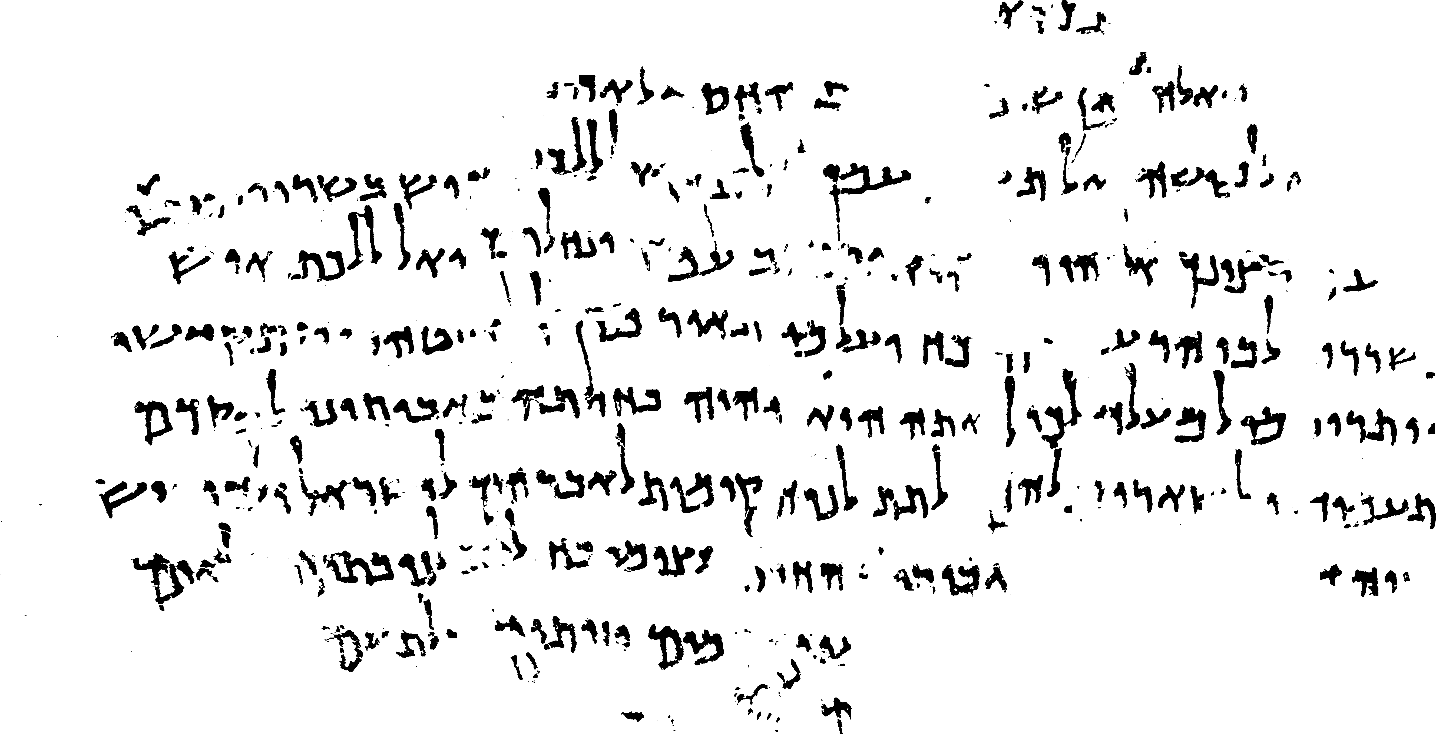
Revealing ink and parchment in Dead Sea Scrolls images
Berat Kurar-Barakat and Nachum Dershowitz
Images courtesy
Israel Antiquities Authority
photographer Shai Halevi
Notes:
Hi everyone. My name is Berat
I am a postdoctoral researcher at Tel Aviv University. My advisor is Professor Nachum Dershowitz.
I am going to talk about "Revealing ink and parchment in Dead Sea Scrolls images"

Slide 2
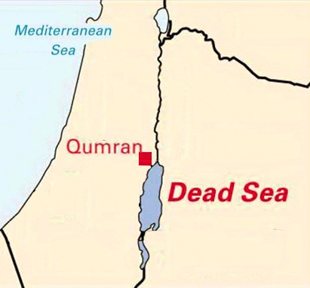
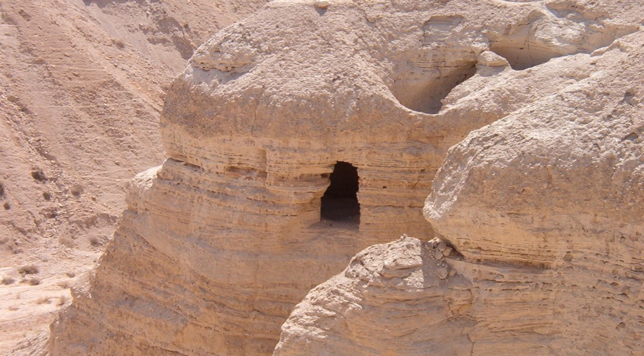
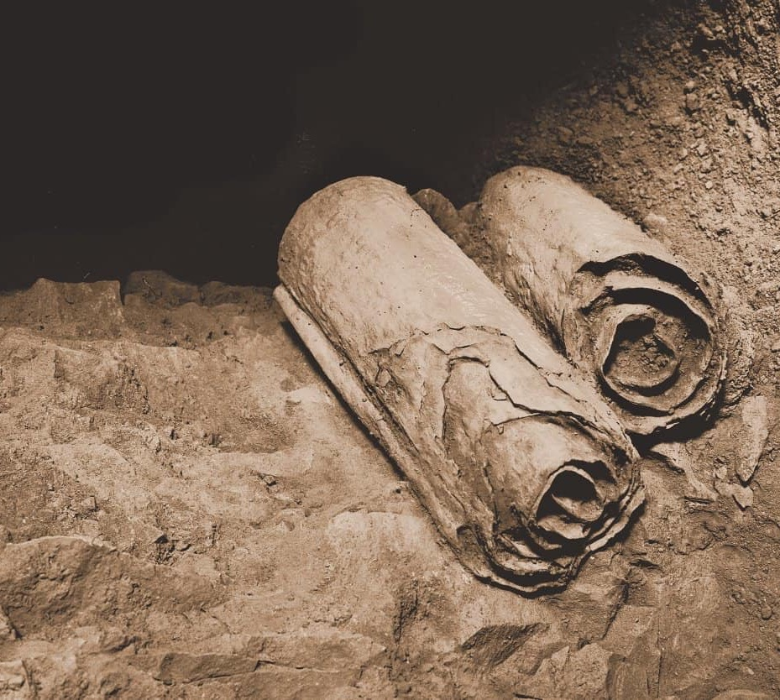
A Qumran cave
2000 years old
A greatest archeological discovery
Discovered between 1946-1956
Dead Sea scrolls
Notes:
The Dead Sea Scrolls are ancient manuscripts that are about 2,000 years old.
They were one of the greatest archaeological discoveries of the 20th century.
The scrolls were discovered in a period of 10 years, between 1946 and 1956, on the northwestern shore of the Dead Sea, in the Qumran Caves, so that we also call them Qumran scrolls.

Slide 3
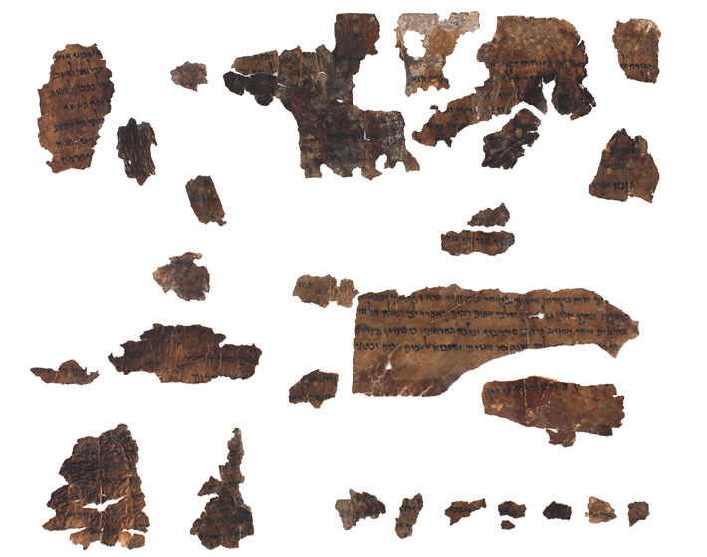
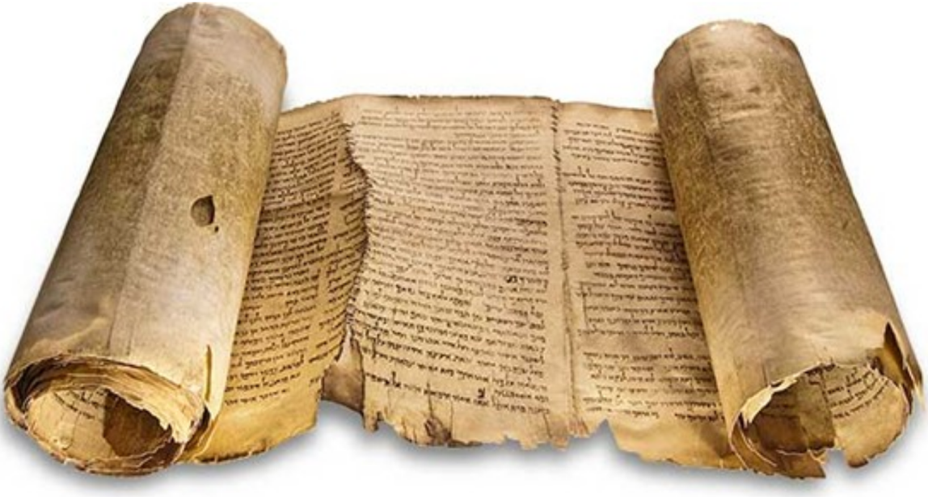
950 different manuscripts
Some well preserved
Some fragmented
Great Isaiah Scroll
734 cm
Isaiah fragments
Notes:
The scrolls include around 950 different manuscripts.
Some of them are well preserved entire scrolls and others are fragmented due to natural causes or human interference.

Slide 4
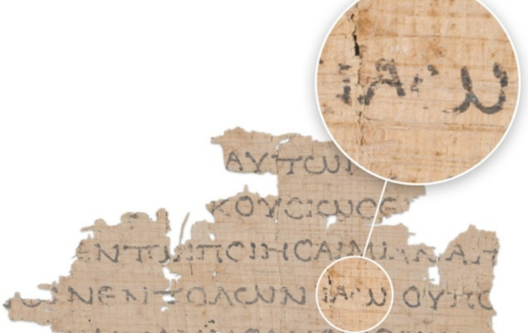
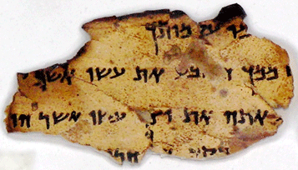
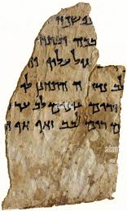
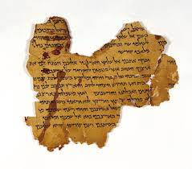
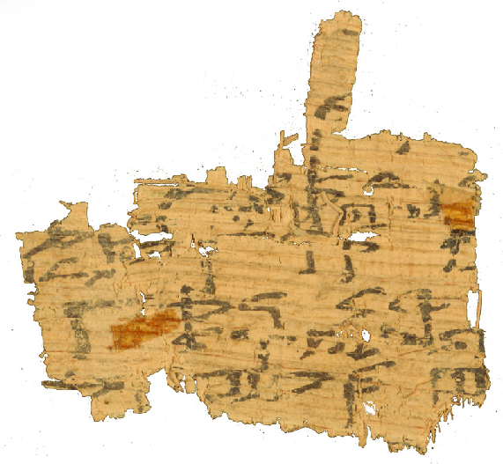
Black carbon-based ink
Parchment fragments
Papyrus
fragments
Notes:
Most of the qumran scrolls are made of parchment, and only a few of them are made of papyrus,
The handwriting on them is written with black carbon-based ink.

Slide 5

Digitization of DSS
IAA digitized DSS and made them publicly available
High resolution
Full color images
Multi spectral images between blue band and near infrared band
Opportunity to develop computational tools
High resolution color and multispectral images
Notes:
Recently, Israel Antiquities Authority digitized the Dead Sea Scrolls and made them publicly available online.
This allows anyone to view and study the scrolls from anywhere in the world.
They provide high resolution full color images and high resolution multispectral images at a range between the blue band and the near infrared band.
These high resolution images give us the chance to develop computational tools for automating their analysis.

Slide 6
What is ink and parchment segmentation?
Notes:
An important step for automating the analysis of dead sea scrolls is to segment the ink and parchment regions on them.

Slide 7
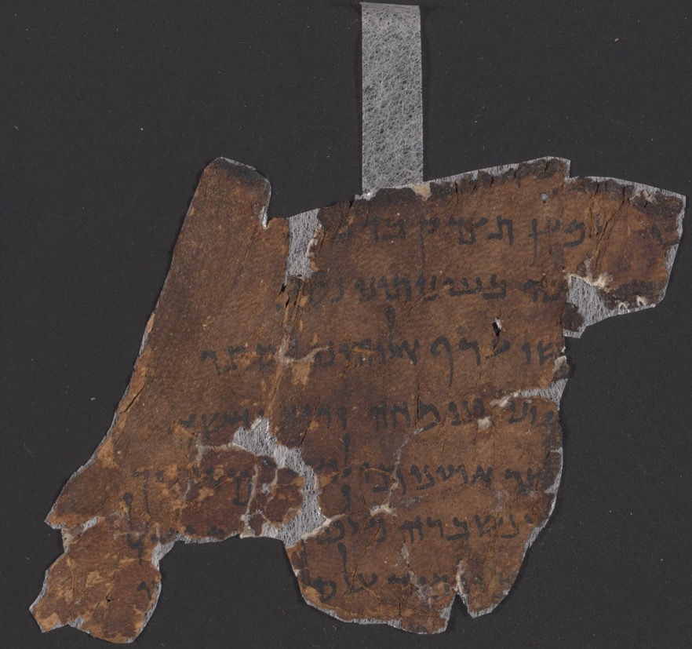
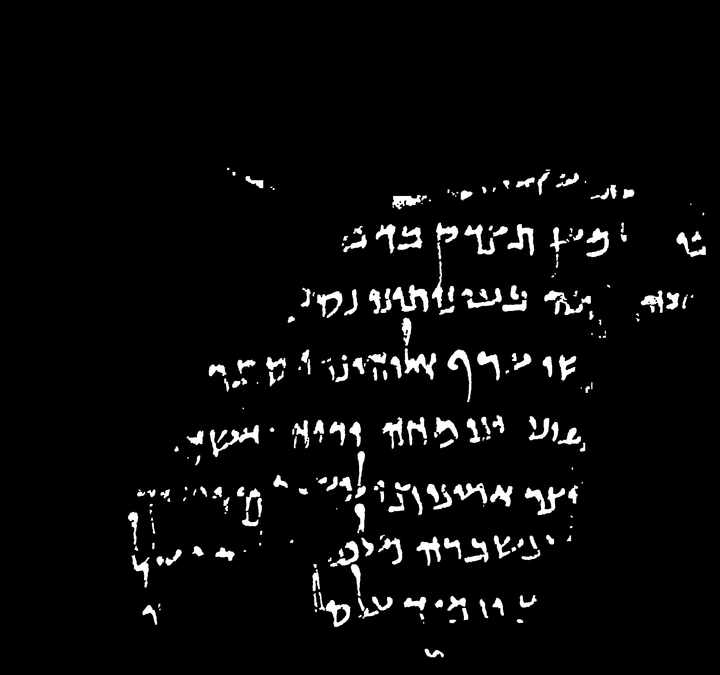
Ink segmentation
Color image
Ink segmentation
Notes:
Ink segmentation is finding the pixels that are from the ink regions

Slide 8
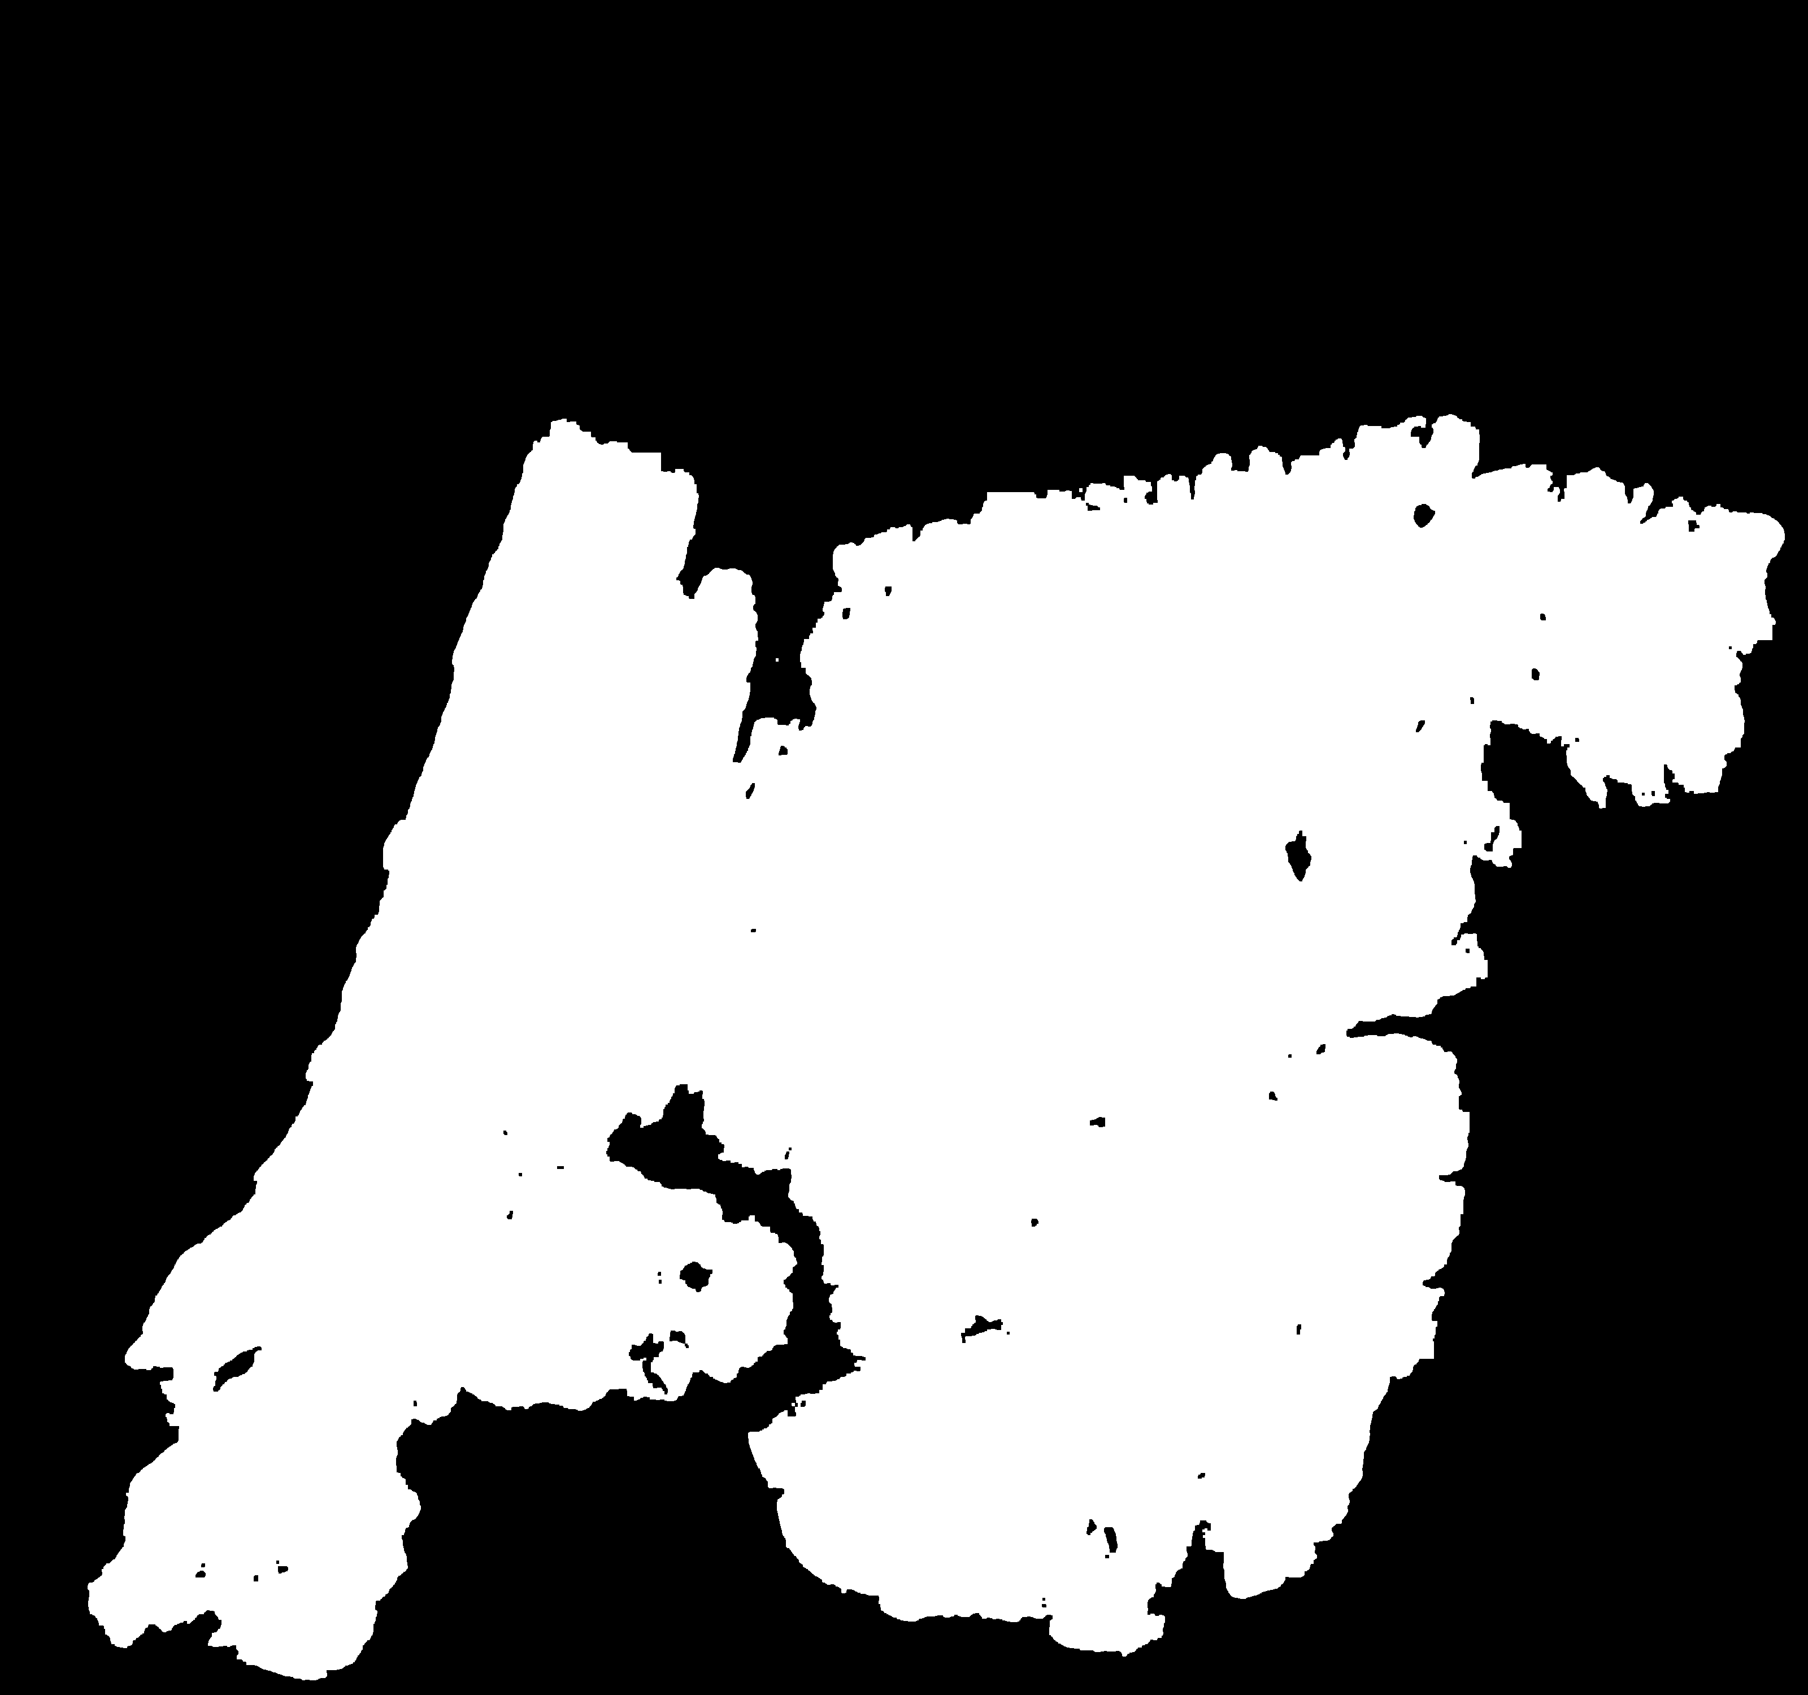
Parchment segmentation
Color image
Parchment segmentation
Notes:
and parchment segmentation is finding the pixels that are from the parchment regions.

Slide 9
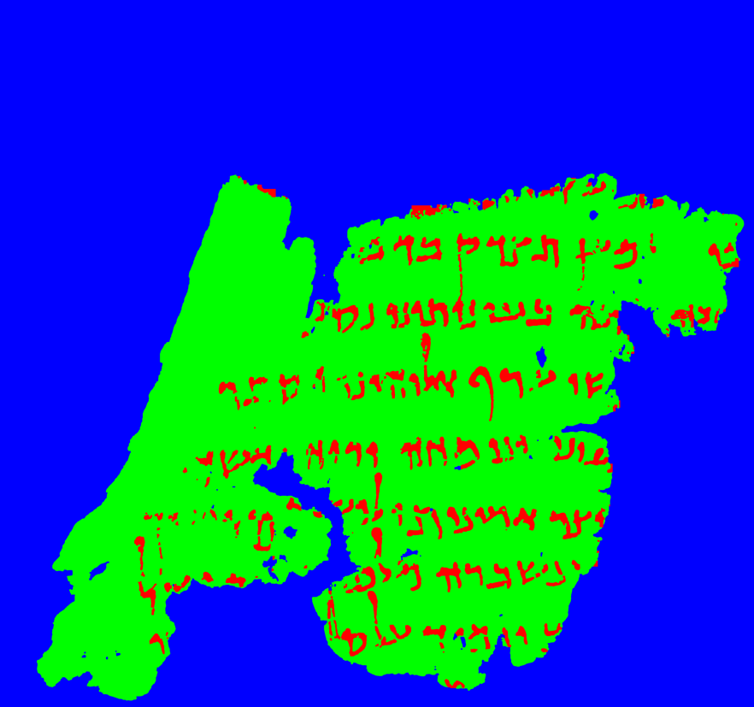
Ink and parchment segmentation
Color image
Ink and parchment segmentation
Notes:
So ideally we want to reach a result something like this where we can know if a pixel belongs to an ink region or a parchment region or a background region.

Slide 10
Why ink and parchment segmentation?
Notes:
Why do we need ink and parchment segmentation? Because

Slide 11
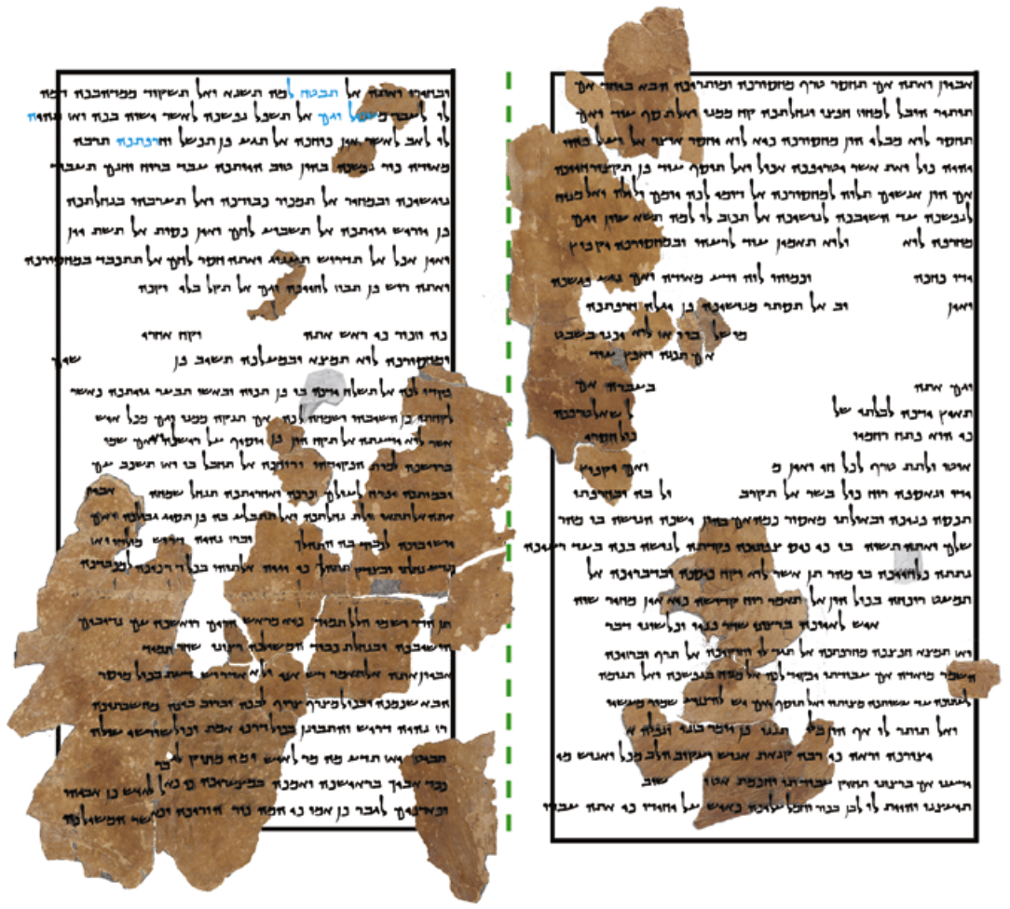
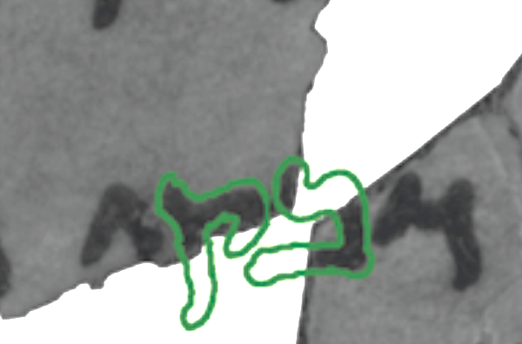
Digital humanities
Using digital tools for solving humanities research problems.
Font generation
Material reconstruction
Ben-Dov et al. 2022
Ben-Dov et al. 2022
Notes:
The availability of high-resolution digital images shifted traditional humanities to digital humanities, which is using off-the-shelf digital tools for solving humanities research problems like material reconstruction using paleographical pairing, geometrical joining and font generation.

Slide 12
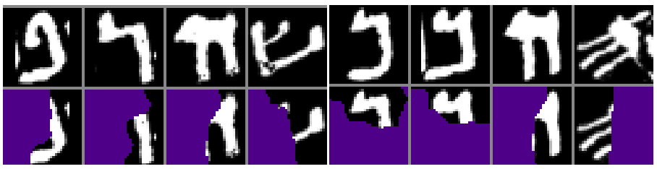
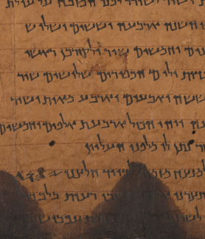
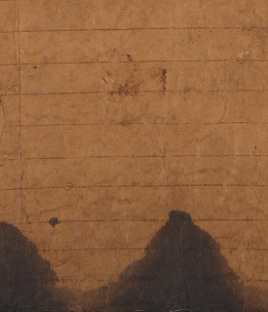
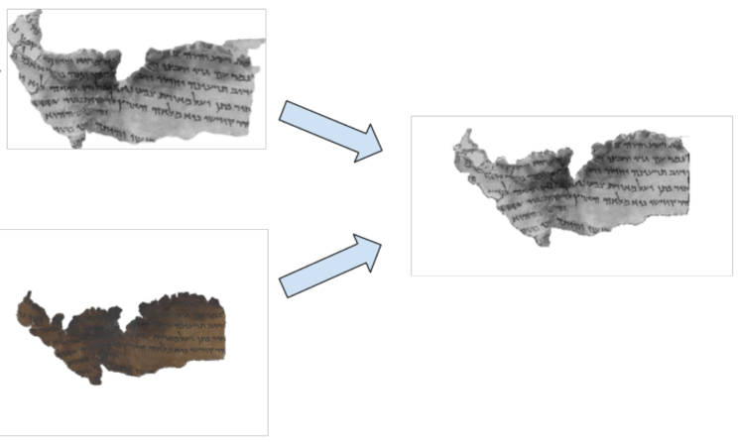
Computational humanities
Letter restoration
Developing digital tools for solving humanities research problems.
Uzan et al. 2022
Matching old and new images
Material analysis
Levi et al. 2022
Reynolds et al. 2022
Notes:
This in turn lead to advances in computational humanities that is developing these digital tools for solving humanities research problems like matching old and new images of a fragment, analysing the writing materials, or restoring the broken letters.

Slide 13
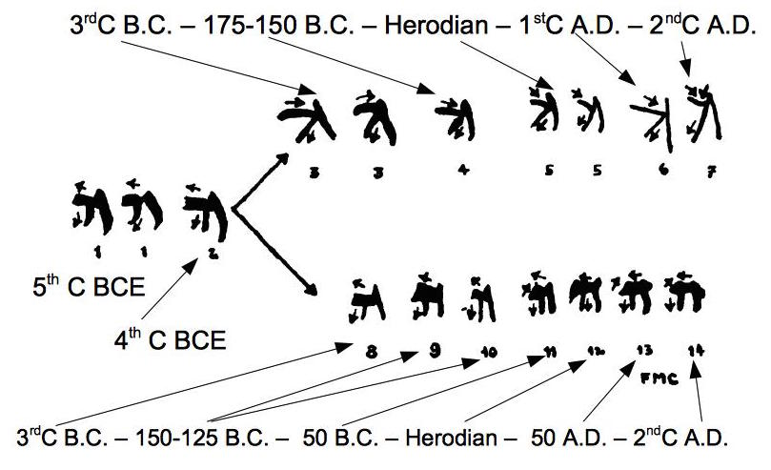
Computational humanities
Developing digital tools for solving humanities research questions.
Manuscript dating by computational paleography
Cross, 1955
Notes:
Or like computational paleography that helps to estimate the date of the scrolls by comparing their handwriting style with the handwriting style of the other dated manuscripts.

Slide 14
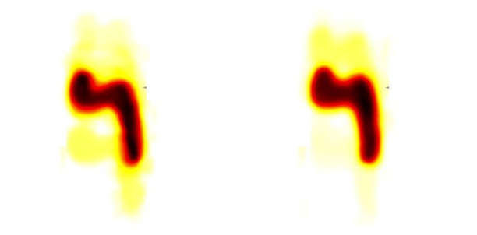
Computational humanities
Developing digital tools for solving humanities research questions.
First scribe
Second scribe
Different resh letters from the two halves of the Great Isaiah Scroll
Popović et al. 2021
Notes:
Or like the computational paleography that helps to identify different scribes who may have written various parts of the scrolls.

Slide 15
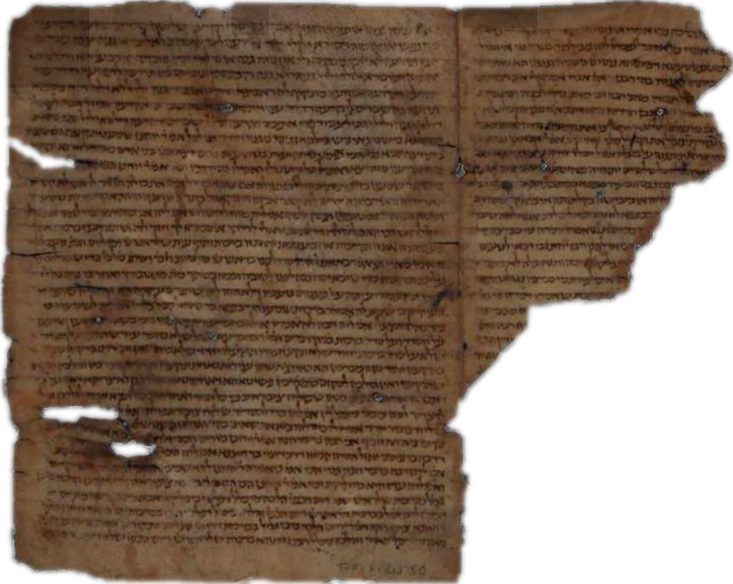
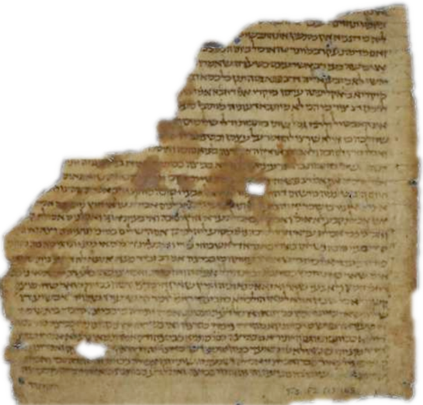
Computational humanities
Developing digital tools for solving humanities research questions.
Fragment pairing
Ben-Shalom et al, 2014
Notes:
Or like the computational paleography that helps to pair the fragments of a scroll by comparing their handwriting styles.

Slide 16



Ink and parchment segmentation
Color image
Parchment segmentation
Ink segmentation
Notes:
So, developing these digital and computational methods heavily depends on ink and parchment segmentation.

Slide 17
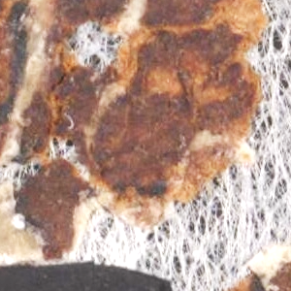
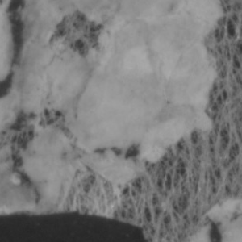
Segmentation challenges
Color image
Near infrared image
Deformed parchment edges
Notes:
But there are some challenges for segmenting the ink and parchment regions in the dead sea scroll images.
For example, there can be deformed parchment edges which complicate their separation from the neighboring regions and increase the manual annotation time.

Slide 18
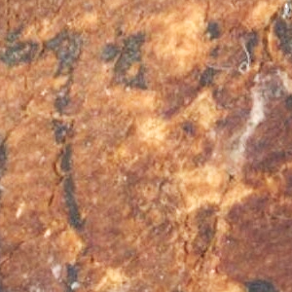
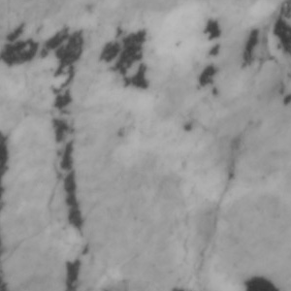
Segmentation challenges
Color image
Near infrared image
Fragmented ink regions
Notes:
There can be fragmented ink regions which increase the manual annotation time.

Slide 19
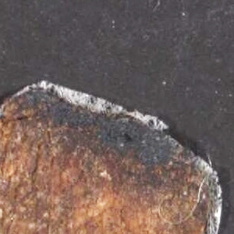
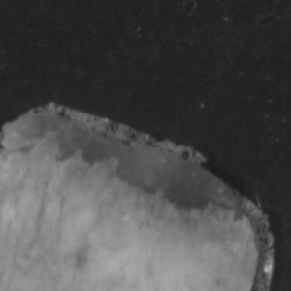
Segmentation challenges
Color image
Near infrared image
Darkened parchment
Notes:
There can be darkened parchment regions which are hard to distinguish from the ink regions and background regions, so they require annotation by experts.

Slide 20
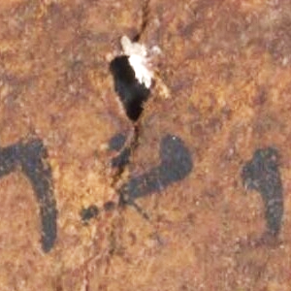
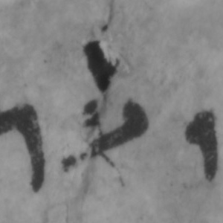
Segmentation challenges
Color image
Near infrared image
Holes
Notes:
There can be holes on the parchment which are indistinguishable from the ink regions and again require annotation by experts.

Slide 21
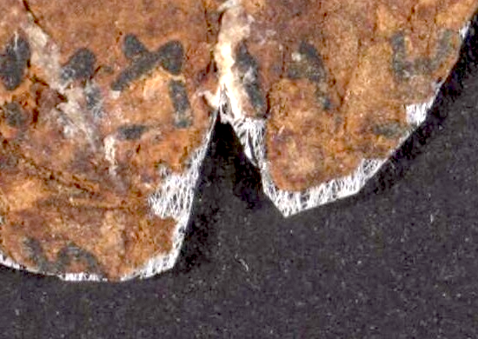
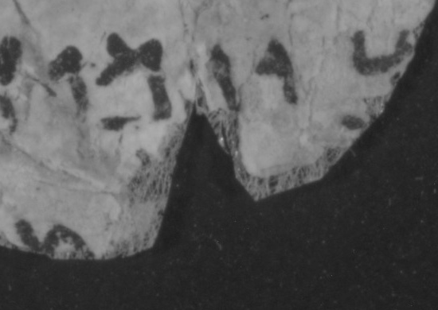
Segmentation challenges
Color image
Near infrared image
Ink near the parchment edges
Notes:
And a very important challenge is that there can be ink regions near the parchment edges whose borders are indistinguishable from the background regions.

Slide 22
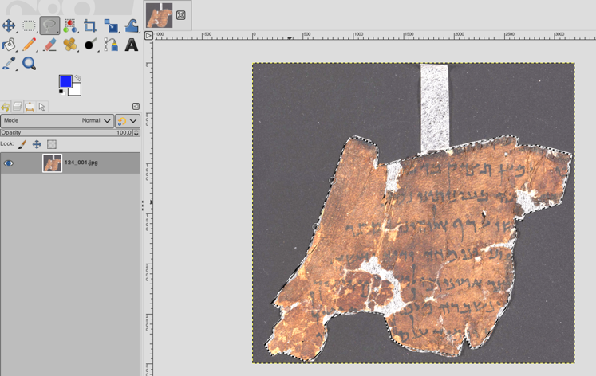
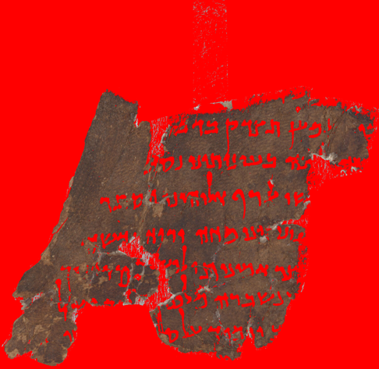


Current solutions
Manual
Conventional
Deep learning
Notes:
So what are the current solutions.
First solution is manual segmentation using an image editing tool. Of course this is very time consuming specially because an IAA image has a high resolution of around 5000 by 7000 pixels.
Second solution is using a binarization algorithm like otsu or sauvola. But a binarization algorithm segments an image only into two regions therefore it does not provide ink and parchment regions separately. Other problem is they cannot discriminate low contrast ink regions from the low contrast hole and background regions. Additionally, they cannot segment the darkened parchment regions from the ink, hole and background regions.
Third and best existing solution is using a deep learning-based pixel-level classifier, but its annotation process is very time consuming again because an IAA image has a resolution of around 5000 by 7000 pixels.

Slide 23

Multispectral thresholding with energy minimization (MTEM)
Ink and parchment segmentation using MTEM
Segment a fragment into ink, parchment and background
Discriminate ink from holes
Discriminate ink from background
Delineate the ink at the parchment edges
Does not rely on manual annotation
Multispectral thresholding for parchment
Energy minimization for ink
Notes:
We propose Multispectral Thresholding with Energy Minimization (MTEM) for segmenting dead sea scroll images into ink, parchment and background regions.
It can discriminate the low contrast ink regions from the low contrast hole regions and background regions.
It can delineate the ink regions at the parchment edges from the background regions
The method is not learning based therefore it does not rely on time consuming manual annotation.
It uses multispectral thresholding for parchment segmentation
and energy minimization for ink segmentation.

Slide 24
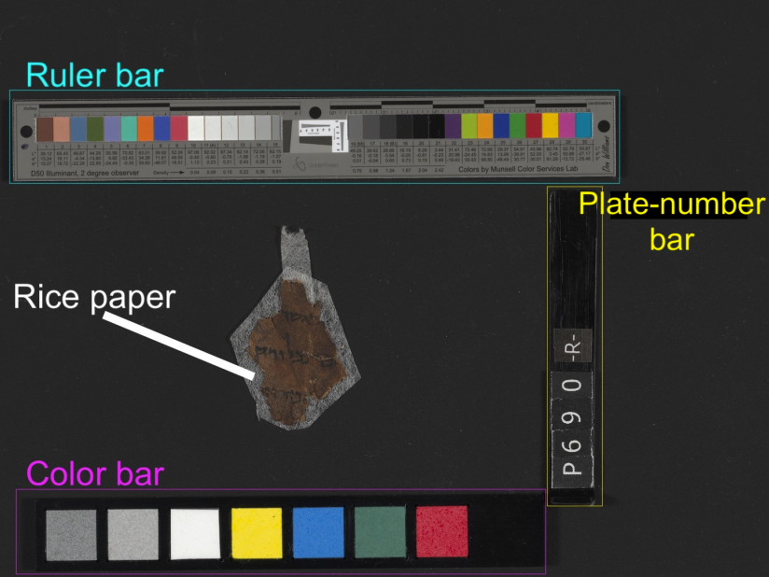
Qumran segmentation dataset (QSD)
Raw IAA image
Publicly available online:
https://www.cs.tau.ac.il/~berat/
20 fragments
Cropped out color bar, ruler bar and plate number bar
Notes:
To develop this solution, we first created Qumran Segmentation Dataset (QSD) which is publicly available online.
The QSD dataset consists of 20 fragments.
We cropped the fragment image to exclude the color bar, ruler bar, and plate-number bar for reducing the dataset size and to keep the focus only on the ink and parchment segmentation problem.

Slide 25
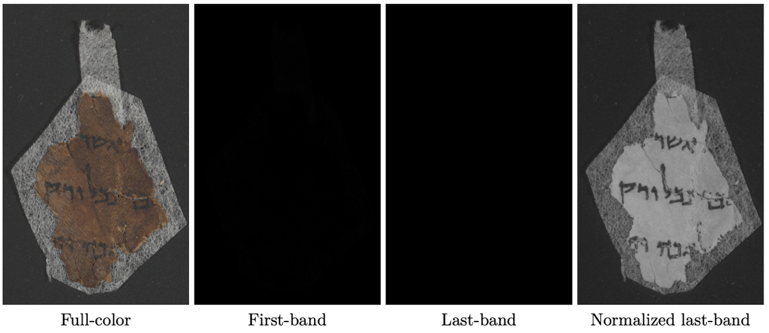
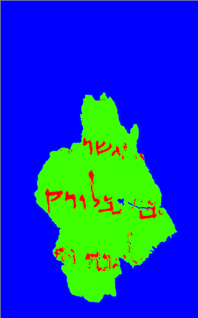
Qumran segmentation dataset (QSD)
Dataset images
Publicly available online:
https://www.cs.tau.ac.il/~berat/
Full-color – 8 bit
First-band – 16 bit
Last-band – 16 bit
Normalized last-band – 8 bit
Pixel-level annotation
Pixel level annotation
Notes:
For each fragment we included its full-color image, first-band image, last-band image and normalized last-band image.
We also included a pixel level annotation for ink, parchment and background regions.
The full-color image shows the natural view of the fragment.
The raw form of the first-band and last-band images are visible only as black.

Slide 26

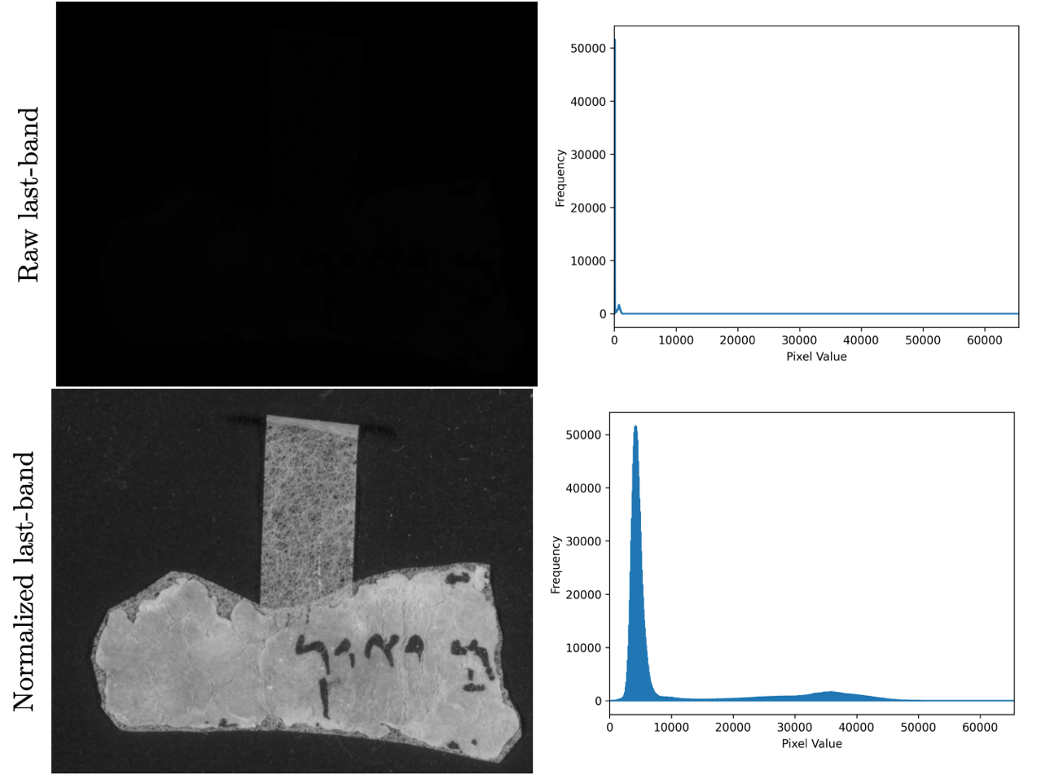
Qumran segmentation dataset (QSD)
Notes:
That is because the actual pixel values span a narrow range in relative to the 16-bit format as we can see in the histogram of the raw last-band image.
So, for qualitative evaluation we normalized last-band images by rescaling their pixel values to the range of 16-bit format.
We selected the last band image for normalization because it contains the maximum contrast difference between the ink and the parchment regions because the parchment is highly reflective of near infrared light.

Slide 27
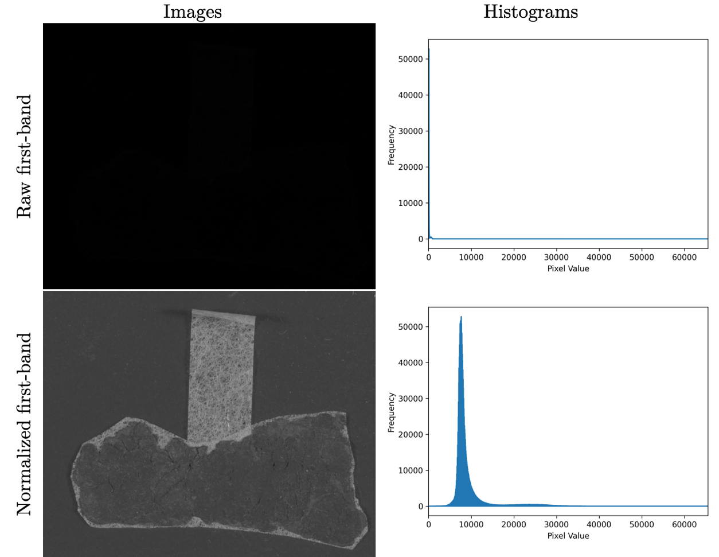
Qumran segmentation dataset (QSD)
Notes:
And here we can see a normalized first band image. The ink is not visible because parchment has the lowest reflection under the first band light. So, it is as dark as the ink and all are visible dark.

Slide 28
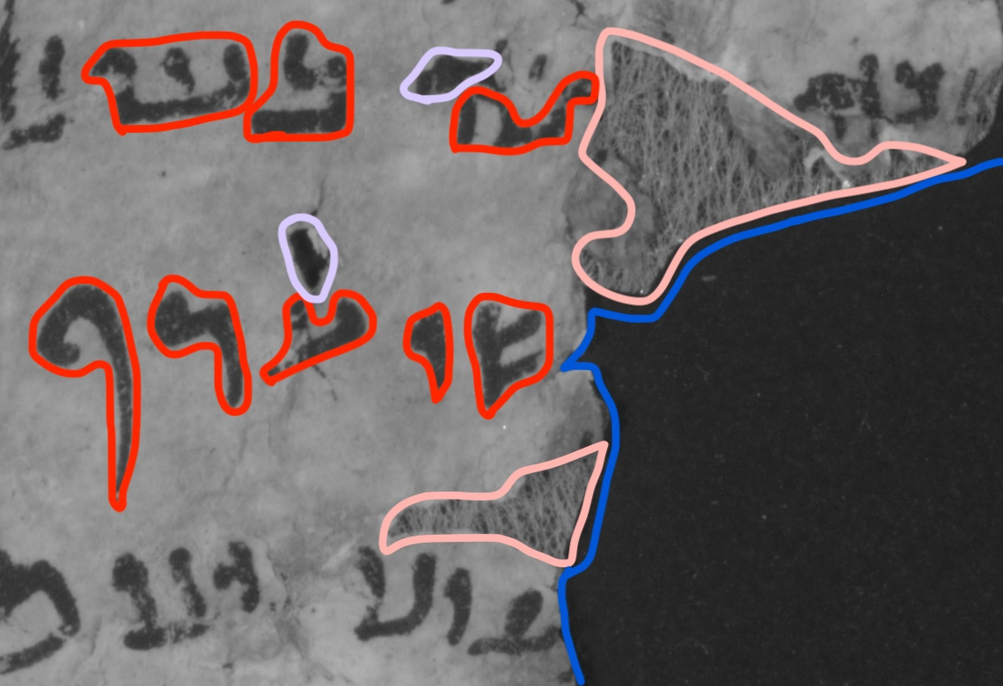
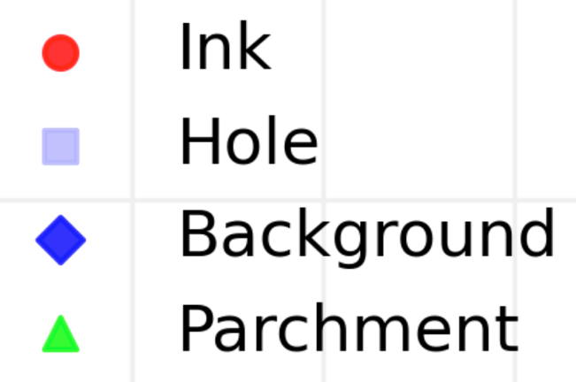

Typical regions in a fragment image
Notes:
After we create the dataset we studied the contents of a fragment image. A fragment image typicaly contains ink regions signed by red color, hole regions signed by purple color, background regions signed by blue color and rice paper regions signed by pink color.

Slide 29
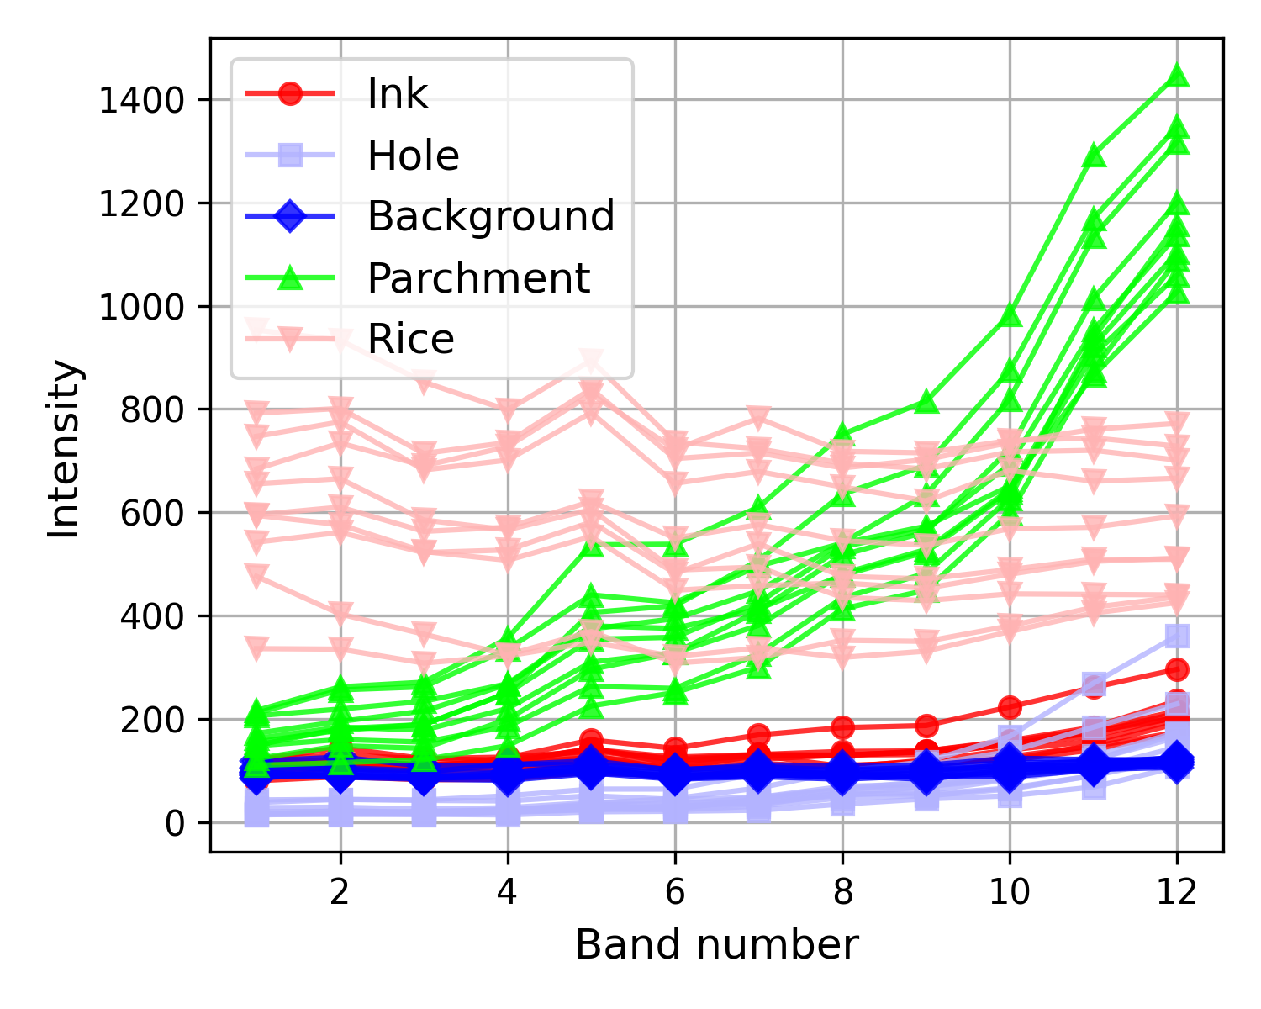
Multispectral characterization
Notes:
Then, we computed the spectral trends of ink, hole, background, parchment and rice paper pixels across the 12 bands.
If we look at the parchment trend in green color, we see that its values at the last band and its slope between the first band and last band discriminates it from all the other regions.
And if we look at the ink trend in red color, we see that it has a slight slope through the last bands.
This slight slope of ink trend seems to distinguish it from the background trend in blue color because it has not slope through the last bands.
But this is not the case for the hole trend in purple color. The hole trend is very similar to the ink trend. they both have a slope through the last bands.
So here the question arises why the holes are different than the background although they are part of the same material.

Slide 30

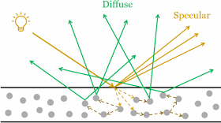
What is a hole?
Infrared light penetrates parchment
Additional diffusive reflections brightens the regions neighboring parchment edges and the ink regions over the parchment
Notes:
We think that this is because the infrared light penetrates into the parchment and causes diffusive reflections in addition to the specular reflections.
These diffusive reflections at the last band image brightens the regions neighbouring the parchment edges or the ink regions that lay over the parchment and cause them to have a slight slope at the end of their multispectral trend.
That means, the holes which are totally surrounded by parchement edges are brigtened by the diffusive reflections.
And the ink which are totally laying over parchment are brightened by diffusive reflections.
As a result the ink and the hole regions have similar spectral trends.

Slide 31
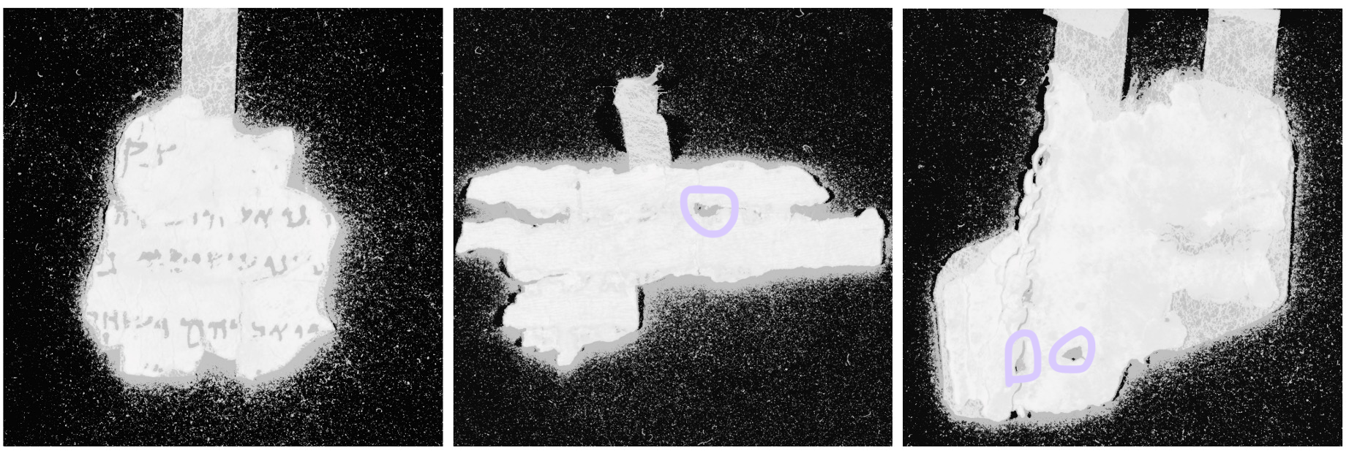
Holes and halos
Hole
Hole
Halo
Halo
Halo
Notes:
And really if we look at the equalized last band images, we can observe that all the background regions neighboring parchment edges and the ink regions laying over the parchment are shining. We call the shining background region surrounded by the parchment a hole and the shining background region around the parchment a halo. Both have the same spectral signature which are similar to the ink’s spectral signature. At this point we can observe how difficult to distinguish the ink from the holes and the halos.
But now let’s keep this challenge aside and look at how to segment the parchment regions.

Slide 32
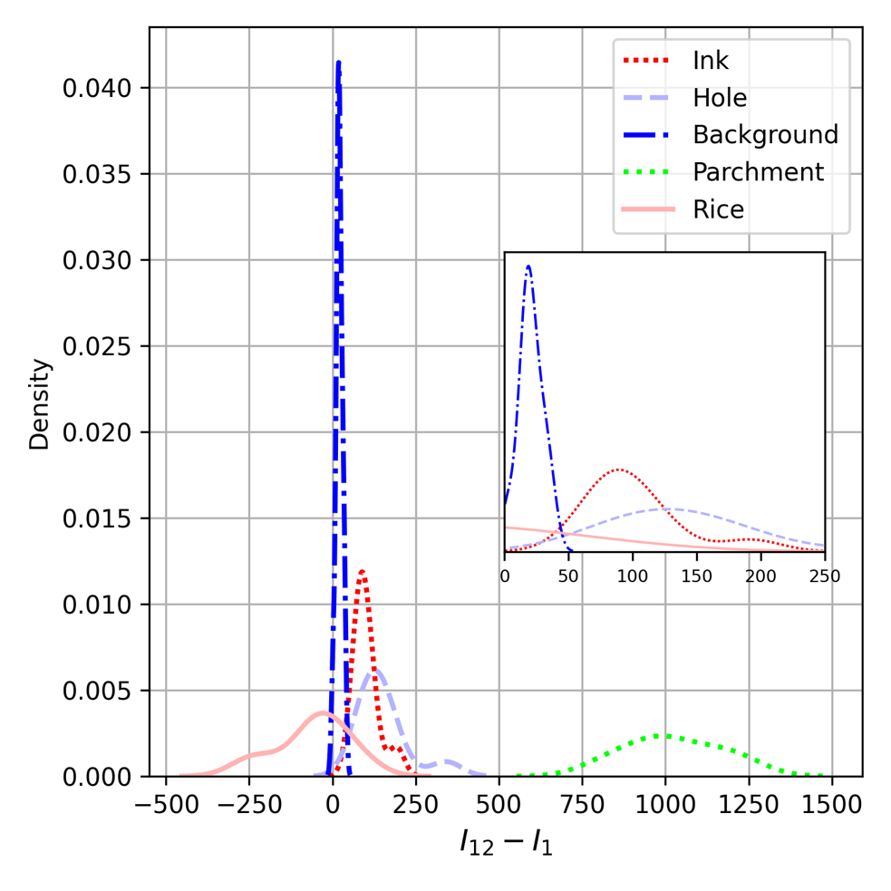
Separability of parchment pixels
Notes:
Here we see the intensity distribution of the difference of last band and first band values.
We can observe that parchment pixels shown in green color, are easily separable from all the other regions only by thresholding the difference of last band and first band values.
But the ink pixels shown in red color are not separable using the difference of last band and first band values. As we expected ink values are overlapping with the hole values.

Slide 33
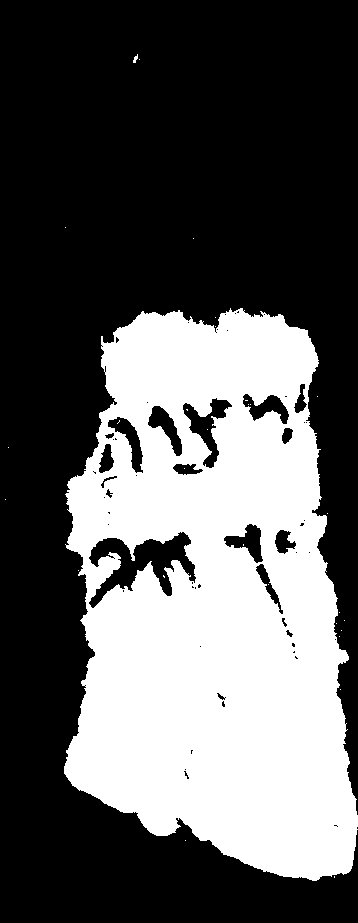
Separability of parchment pixels
Parchment segmentation by thresholding the difference of last band and first band values
Notes:
Here is an example image that shows the parchment segmentation we get by thresholding the difference of last band and first band values.
It is quite well.

Slide 34
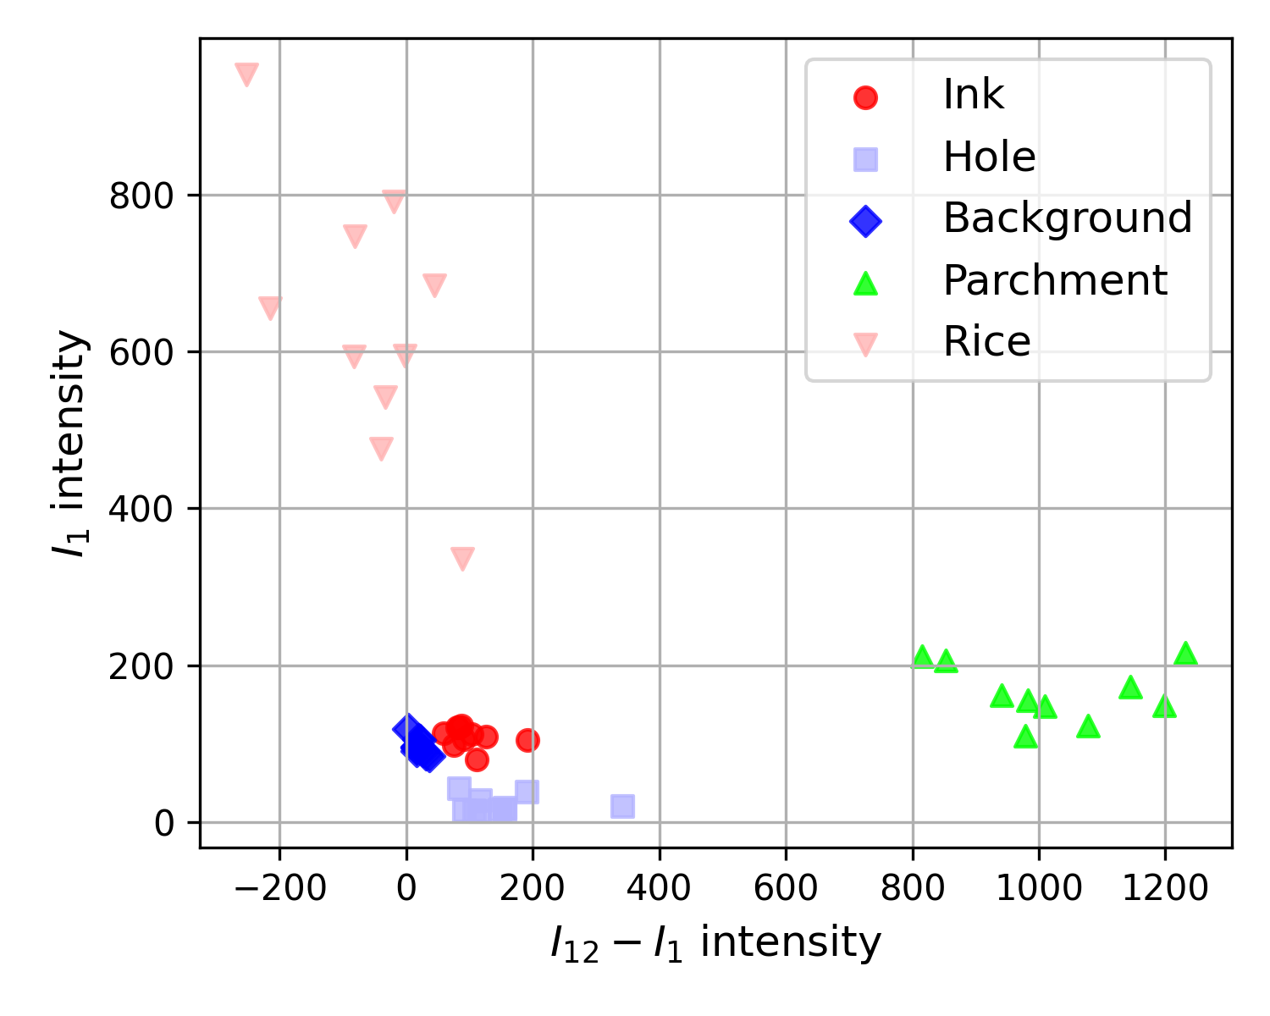
Separability of ink pixels
Notes:
Now let’s look at the separability of the ink pixels.
We can get the maximum possible separability for the ink pixels using the plot of first band values versus the difference of last band and first band values.
But still, their separability is not as good as the parchment.

Slide 35

Separability of ink pixels
Ink segmentation by thresholding the first band values and thresholding the difference of last band and first band values
Notes:
Here is an example image that shows the ink segmentation that we get by thresholding the first band values and thresholding the difference of last band and first band values.
As we expected it is not a good enough segmentation. It does not contain all the pixels of the ink regions as it contains some pixels from other regions specially from holes and halos regions.
So, we need to look for another solution

Slide 36


Ink contour segmentation
Ink contour segmentation by thresholding the first band values and thresholding the difference of last band and first band values
Notes:
We observed that the ink contours are more distinguishable than ink regions due to their thinner ink layer. Because this allows greater diffusive reflection from the underlying parchment.
At the left plot we can see that ink contour trend in brown color is different than the background trend in blue color and different than the hole trend in purple color, more than the difference of the ink trend from them. So, we decided to threshold the ink contours.
The right image shows the ink contour segmentation we get by thresholding the difference of last band and first band values.
We need to keep in mind that the ink contour segmentation is not perfect, because it contains some pixels that are not from ink contour regions.

Slide 37

Current result
Parchment
Ink contour
Notes:
So now, we have the parchment segmentation and a non-perfect ink contour segmentation using multispectral thresholding.
What to do next to get the ink segmentation?

Slide 38

Energy minimization formula
Data Cost
Encourages each pixel to have the closest label
Smoothness Cost
Encourages neighboring pixels to have the same label
Notes:
We used energy minimization algorithm with a data cost that encourages each pixel to have the label of the nearest region and with a smoothness cost that encourages neighboring pixels to have the same label.
Here the smoothness cost can handle the problem of non-perfect ink contour segmentation.
It can also deal with the problem of ink regions neighboring the background regions and can delineate the border between an ink and a background region.

Slide 39



Multispectral thresholding with energy minimization (MTEM)
Parchment
Background
Ink and background
Pulls background
Pulls ink
Ink contour
Ink
Notes:
Here is what happens actually.
At left we have the ink and background regions together, that is simply the inverse of the parchment segmentation.
Our task is to get the ink segmentation and the background segmentation separately from this segmentation.
We use parchment segmentation to pull the background pixels because the parchment is closer to the background pixels more than the ink contours are
And we use ink contour segmentation to pull the ink pixels, because the ink contours are closer to the ink pixels more than the parchment is
Finally we have the ink segmentation and background segmentation separately.

Slide 40

Multispectral thresholding with energy minimization (MTEM)
Notes:
Here is the resulting ink and parchment segmentation on the whole fragment image.
We can see that in can segment the low contrast ink regions from the low contrast background and holes regions.
And it can delineate the ink regions neighboring the background regions.
Now let’s have a close look at the results

Slide 41




Multispectral thresholding with energy minimization (MTEM)
Input
Otsu
GrabCut
MTEM
Notes:
The proposed method can distinguish the ink regions from the hole regions unlike the conventional binarization methods.

Slide 42




Multispectral thresholding with energy minimization (MTEM)
Input
Otsu
GrabCut
MTEM
Notes:
It can distinguish the ink regions from the rice paper regions. But the binarization algorithms cannot distinguish the rice paper regions because of its holed structure contains dark regions.

Slide 43




Multispectral thresholding with energy minimization (MTEM)
Input
Otsu
GrabCut
MTEM
Notes:
The proposed method can delineate the ink boundaries that are neighboring the background regions. Of course, this is not the case for the binarization algorithms because they are not designed to discriminate between the low contrast ink regions from and the low contrast background regions.

Slide 44

Multispectral thresholding with energy minimization (MTEM)
Notes:
This is an example of a parchment with some darkened regions.
The ink regions on the darkened parchment were abele to be revealed.

Slide 45

Multispectral thresholding with energy minimization (MTEM)
Notes:
This is an example of a parchment with quite amount of script with many holes and rice paper regions among them.
Here an important thing to mention is that

Slide 46


Multispectral thresholding with energy minimization (MTEM)
Notes:
The multispectral thresholding with energy minimization method does not rely on any morphological or edge detection operations and makes no assumptions about the component size.
That’s why, the segmentation of a part of an image is consistent with its segmentation as part of the entire image.

Slide 47

Error cases
Notes:
Of course it does not always work perfectly.
Now let’s look at some error cases.
The proposed method cannot properly segment the parchment regions whose reflection is reduced because of contaminants like salt and soil or external factors like humidity and temperature.

Slide 48

Error cases
Notes:
Also it cannot segment the ink regions who does not have contours again because of contaminants or external factors.

Slide 49

Quantitative results
Notes:
This table shows the quantitative evaluation results.
To the best of our knowledge there isn’t any pervious method for segmenting ink and parchment of dead sea scrolls.
And there isn’t any previous method for segmenting dark ink regions from dark background regions except a deep learning method that is based on manual annotation.
Therefore we compared our parchment segmentation with conventional binarization methods Otsu and Sauvola.
For the parchment segmentation, the proposed method overperform the binarization methods by a margin of around 30 percent.
As for the ink segmentation, the proposed method achieves an accuracy of 75 percent.

Slide 50

More results on ink and parchment segmentation using MTEM
Thank you!
Notes:
Thank you for your time and attention. I look forward to your questions.
And I also have a question that is
The IAA images background is selected as black in order to eliminate the noisy reflections. This may be valid for the full color images, but it does seem so for the near infrared light images. What could be the solution to be considered for the next digitization projects, do you think?

